Slide 1
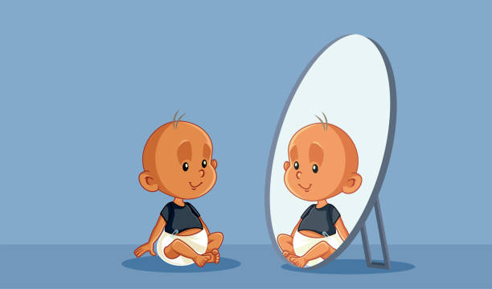

Notes:
Hi there and welcome to our study!
In this study, we are interested in what babies do when they see themselves on the screen. Let me walk you through what’s going to happen.

Slide 2

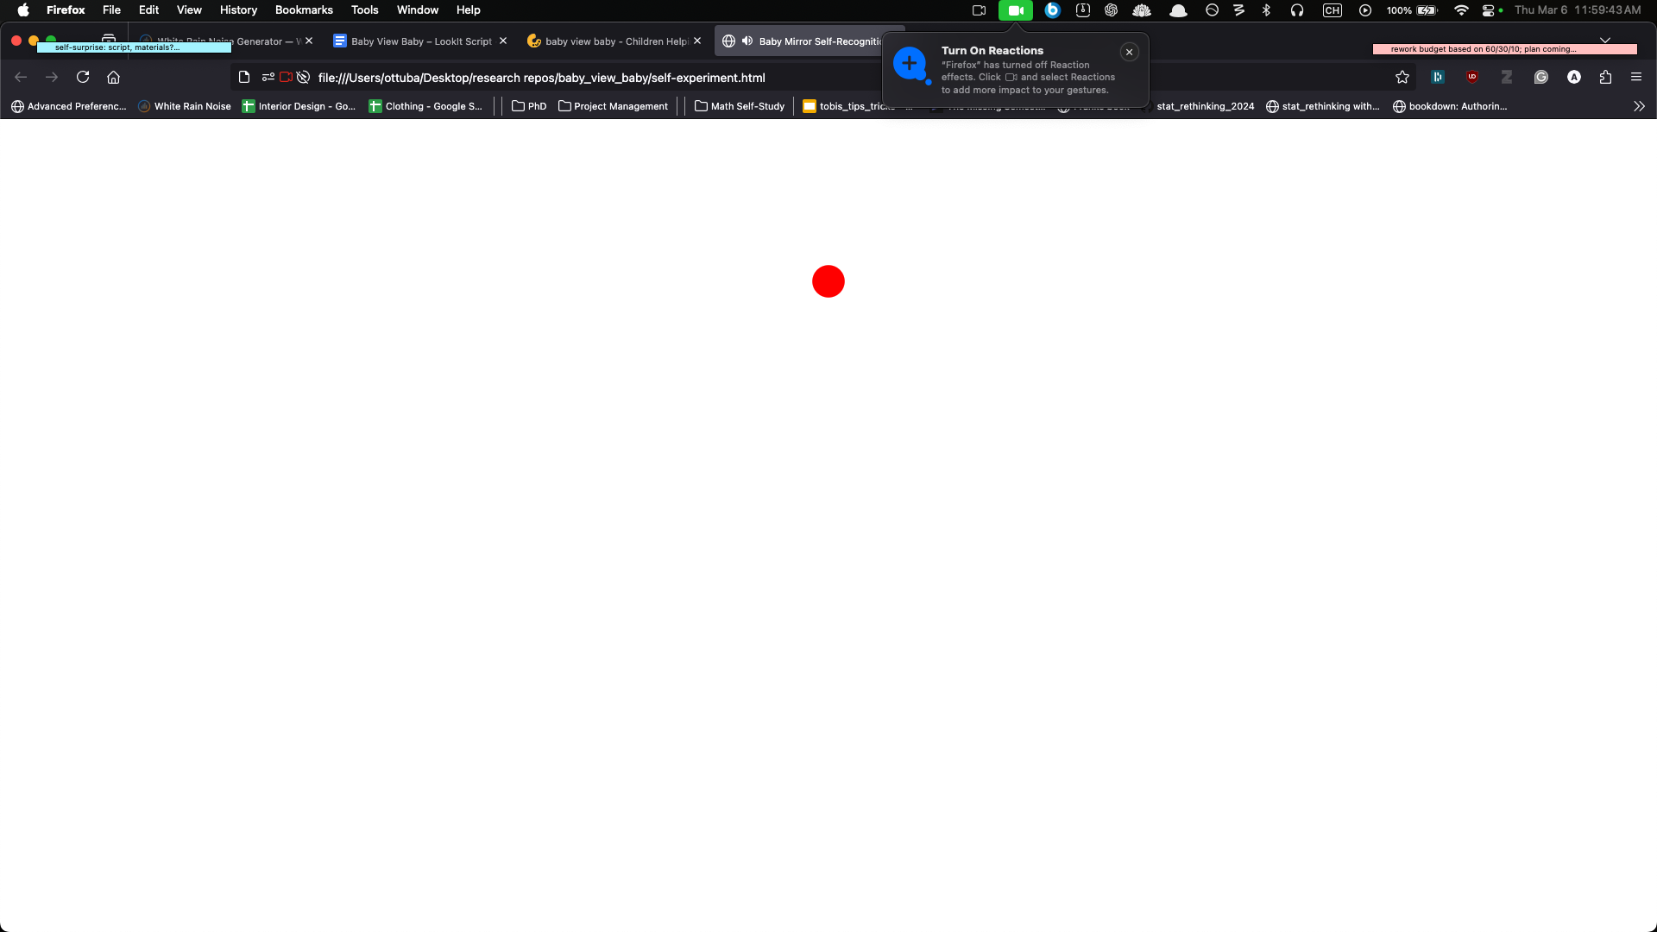
Attention-getter (~10 seconds)
Notes:
First, your child will see an exciting jumping dot moving around the screen; it’s called an attention-getter, because we use it to get your child to attend to the screen.

Slide 3


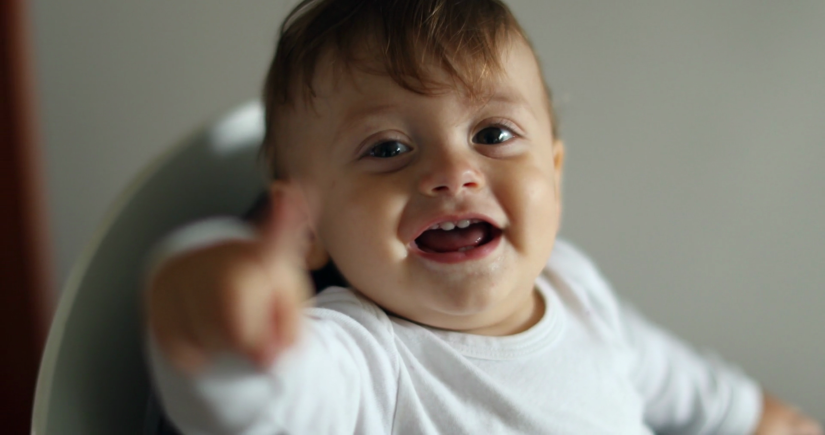
~3 min
ends automatically
Notes:
Then, your child will see a live webcam feed of themselves on the screen, with some music in the background, for 3 minutes. That’s really all they do in this study, super simple! The live webcam feed will end automatically after 3 minutes, right when the music stops playing, and we will ask you a few questions at the end.

Slide 4
Questions
Notes:
The live webcam feed will end automatically after 3 minutes, right when the music stops playing, and we will ask you a few questions at the end.

Slide 5
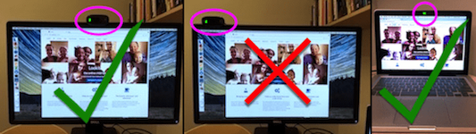
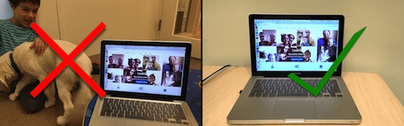
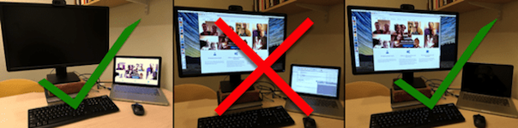
Use only ONE monitor (turn others off)
Quiet place with minimal distractions (e.g., no toys, siblings, pets, windows)
Webcam should be centered
Notes:
There are a few important things to keep in mind:
First, please find a quiet place to complete the study, away from other interesting things. (the slide says: windows, toys, pets, siblings [photos from instruction screen]), and make sure the webcam is centered on the screen. If your setup has more than one monitor, please make sure to use only ONE.

Slide 6
Please avoid interrupting your child’s responses or telling them what to do!
Notes:
Second, please let your child be. Once the live video feed starts, it is very important that you avoid interacting with your child or telling them what to do – we want to observe what your child does on their own. If your child looks at you, you can smile and nod, but please don’t talk or point to the screen or try to change their behavior in any way.

Slide 7
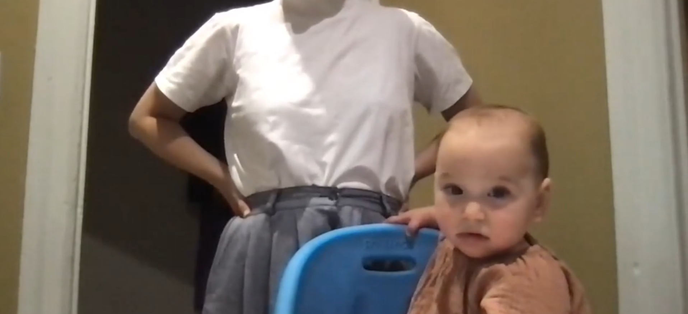
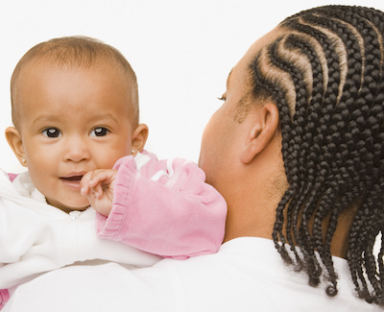

Please make sure your child’s face is the only face on the screen!
to stop!
Notes:
Third, please make sure that the only face on the screen is your child’s face. This means you or any other family members should stay out of the camera’s view
There are a few ways to do this.
First, you can hold your child to face the camera over your shoulder while YOU face away from the camera, like this!
Alternatively, if your child is old enough to sit on their own, you can have them sit in front of the camera and you can stay off screen, like this! (show image).
If you have other ideas, that’s great too! The important thing is to make sure that the child’s face is the only face on the screen.
Lastly, if your child is getting too distracted or distressed at any point, you can stop the session by pressing E on your keyboard.

Slide 8
Notes:
Thank you for participating, and we hope you and your child have fun!

